Slide 1
SALES INSIGHTS
File created on: 8/12/2022 2:35:58 PM

Slide 2
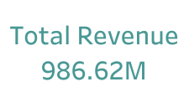

Slide 3
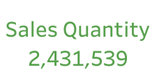

Slide 4


Slide 5
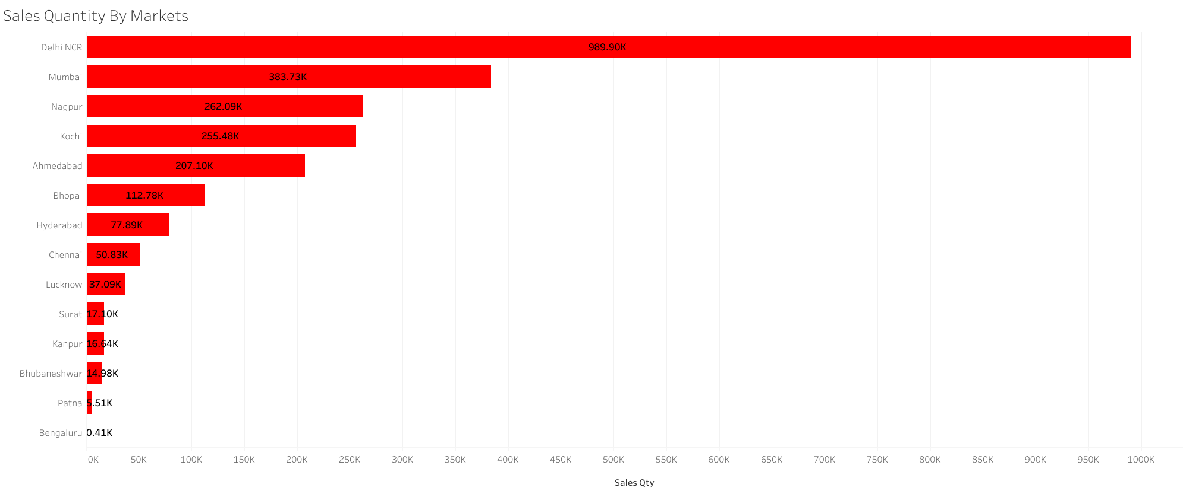

Slide 6
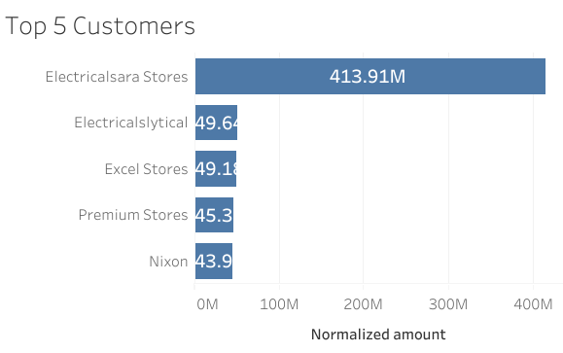

Slide 7


Slide 8
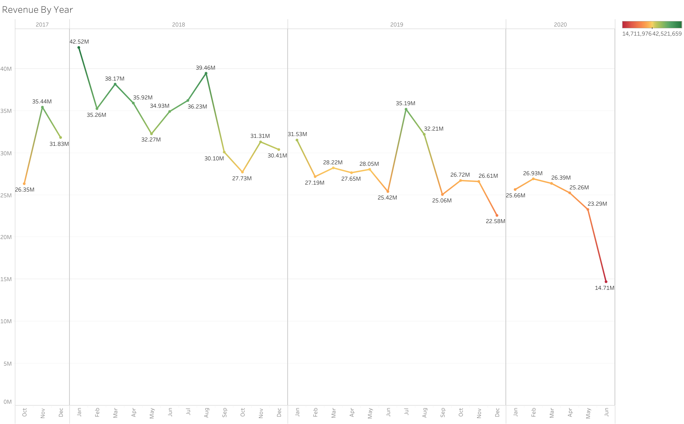

Slide 9


Slide 11
